Slide 1
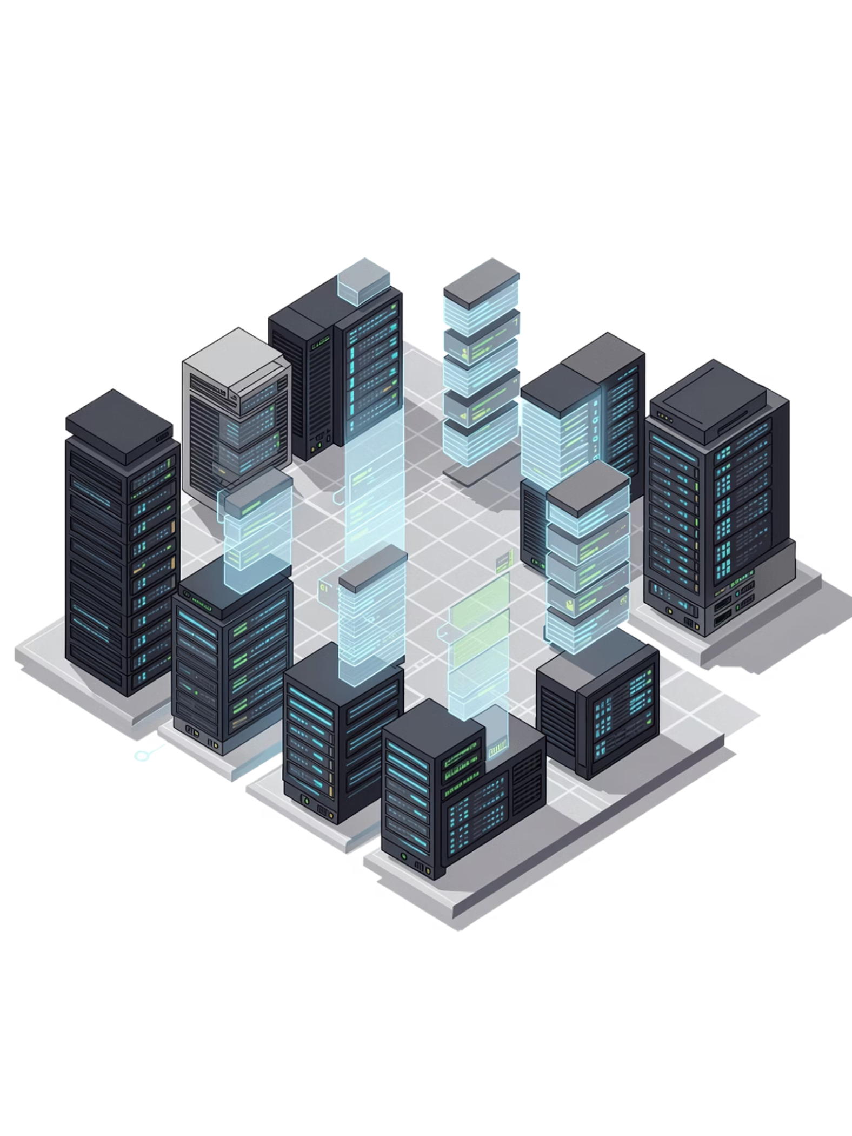
Delta Lake: The Reliability Revolution
From chaotic data lakes to trustworthy, ACID-compliant pipelines
🌐 www.cloudpandith.com | 📞 8904424822

Slide 2
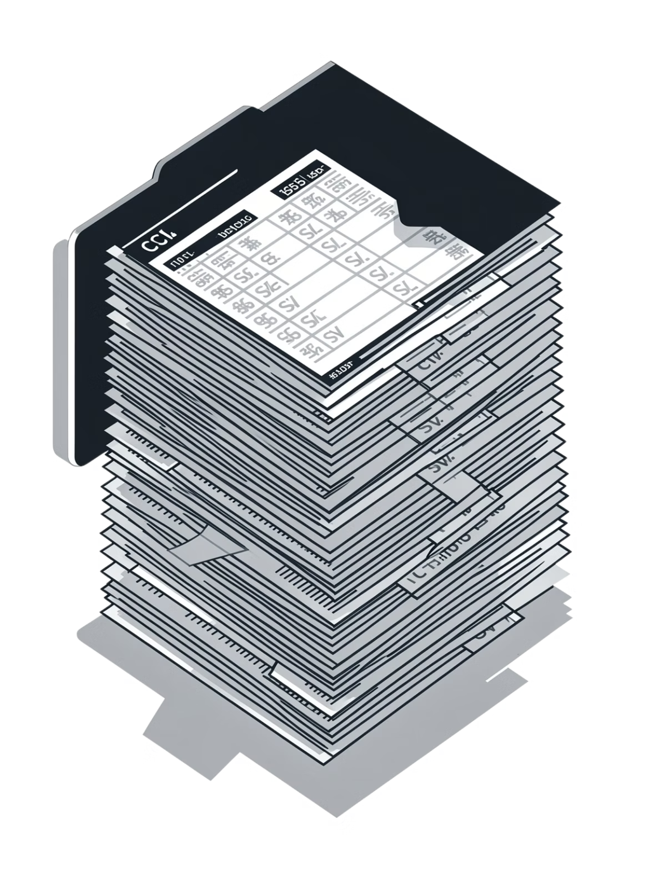
Can You Trust Your Data Lake?
Imagine 1,000 CSV and Parquet files sitting in a data lake. Ask yourself:
No Duplicates?
Can you guarantee every record appears exactly once?
No Partial Writes?
What happens when a write job crashes halfway?
Correct Updates?
Can you actually update or delete a row reliably?
Easy Rollback?
If something goes wrong, can you go back in time?
"That's exactly where traditional data lakes fail."
🌐 www.cloudpandith.com | 📞 8904424822

Slide 3
Problems with Traditional Data Lakes
Cheap storage — but far from a reliable data system. Here's why raw data lakes break in production:
❌ No ACID Transactions
❌ No Schema Enforcement
❌ No Updates or Deletes
If a write fails midway, your data is corrupted. No recovery path exists.
Only append is supported. True ETL — including corrections — is practically impossible.
A column typed as int today becomes a string tomorrow — silently breaking pipelines.
❌ Concurrency Conflicts
❌ No Streaming + Batch Unity
Two jobs writing simultaneously leads to data races and corrupted output.
Combining real-time and batch workloads on the same table is unreliable and complex.
🌐 www.cloudpandith.com | 📞 8904424822

Slide 4
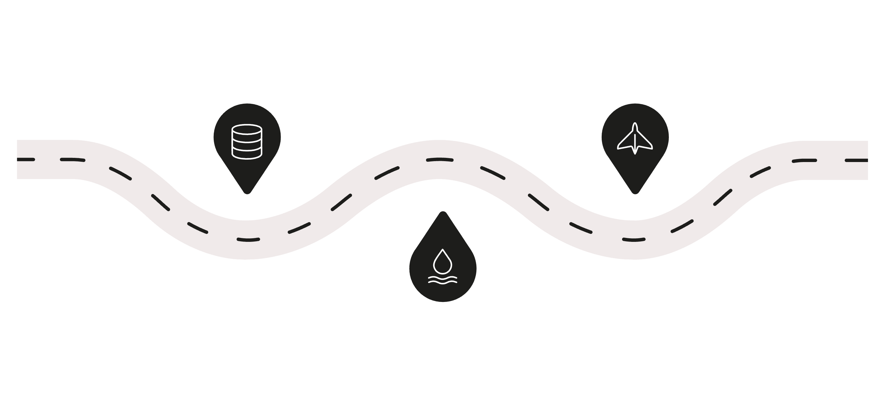

The Evolution: Warehouse → Lake → Delta
Every generation of data architecture solved some problems — but introduced new ones. Delta Lake brings the best of both worlds.
Data Warehouse
Delta Lake
Reliable, scalable, and cost-effective
Reliable but costly and rigid
Data Lake
Cheap and scalable but unreliable
"Delta Lake = Data Lake + Reliability Layer"
🌐 www.cloudpandith.com | 📞 8904424822

Slide 5
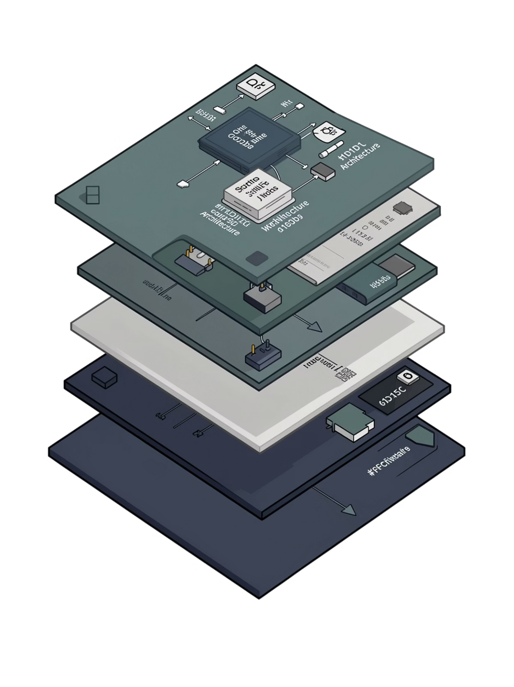
What Is Delta Lake?
Delta Lake is an open-source storage layer that brings ACID transactions, schema enforcement, and full reliability to your existing data lake — without changing your storage infrastructure.
Open Source
Backed by Linux Foundation. Works on any cloud.
Built on Parquet
Data stays in open Parquet format — no vendor lock-in.
ACID Guaranteed
Every operation is atomic, consistent, isolated, and durable.
Unified Engine
One table for both streaming and batch workloads.
🌐 www.cloudpandith.com | 📞 8904424822

Slide 6
Core Concepts: How Delta Lake Works
Transaction Log
ACID Transactions
Every change is recorded in _delta_log — like a bank passbook. "Data is in Parquet, control is in the log."
Atomic, Consistent, Isolated, Durable. All or nothing — no half-written data, ever.
Schema Enforcement
Time Travel
Rejects bad data at write time. Allows safe schema evolution without breaking pipelines.
Query any previous snapshot: VERSION AS OF 2. Debugging and auditing made effortless.
Upserts via MERGE
Batch + Streaming
Update and insert in one atomic statement. True ETL is finally possible on a data lake.
The same Delta table serves both real-time streaming and scheduled batch jobs simultaneously.
🌐 www.cloudpandith.com | 📞 8904424822

Slide 7
Real-World Impact: Student Enrollment System
Let's make it concrete. A live enrollment platform processing thousands of records daily exposes every data lake weakness — and every Delta Lake strength.
❌ Without Delta Lake
✅ With Delta Lake
Duplicate student records after retry logic
Partial payment entries when job crashes
No rollback when wrong data is loaded
Schema drift silently breaks downstream reports
MERGE ensures clean, deduplicated upserts
Atomic writes — either all data lands or none does
Roll back to any prior version in seconds
Schema enforcement blocks bad data at the gate
🌐 www.cloudpandith.com | 📞 8904424822

Slide 8
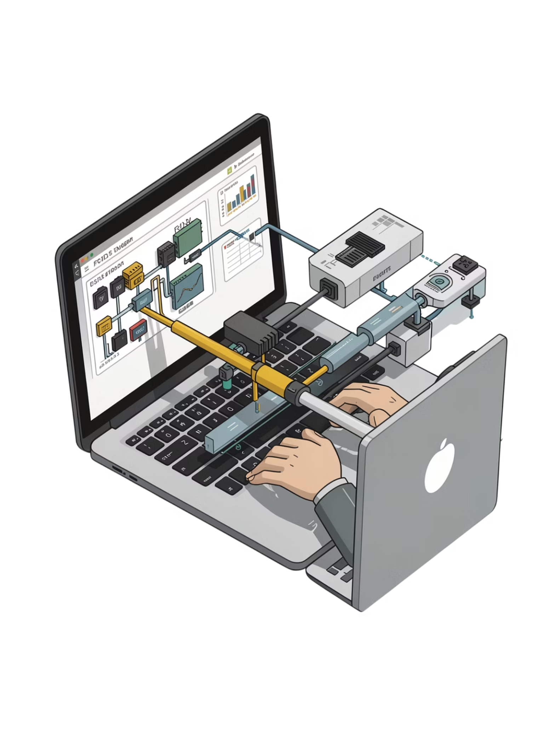
Why Data Engineers Choose Delta Lake
ACID
1×
Guaranteed
Unified Table
Every transaction is safe, consistent, and durable
Batch and streaming on the same table — no duplication
∞
Version History
Time travel to any prior snapshot for audit or debug
"Without Delta → engineers fix data. With Delta → engineers build features."
🌐 www.cloudpandith.com | 📞 8904424822

Slide 9

Delta Lake Powers Every Modern Platform
Delta Lake isn't a niche tool — it's the foundation of the modern lakehouse. Every major cloud data platform has adopted it as the default storage format.
Databricks
Microsoft Fabric
Azure Synapse
Invented Delta Lake. It's the native table format for all Databricks workloads.
OneLake uses Delta/Parquet as the default open format across all workloads.
Synapse Analytics supports Delta Lake natively for both SQL and Spark pools.
Would you trust business decisions on raw data lake tables? That's why every modern platform ships with Delta built in.
🌐 www.cloudpandith.com | 📞 8904424822

Slide 10
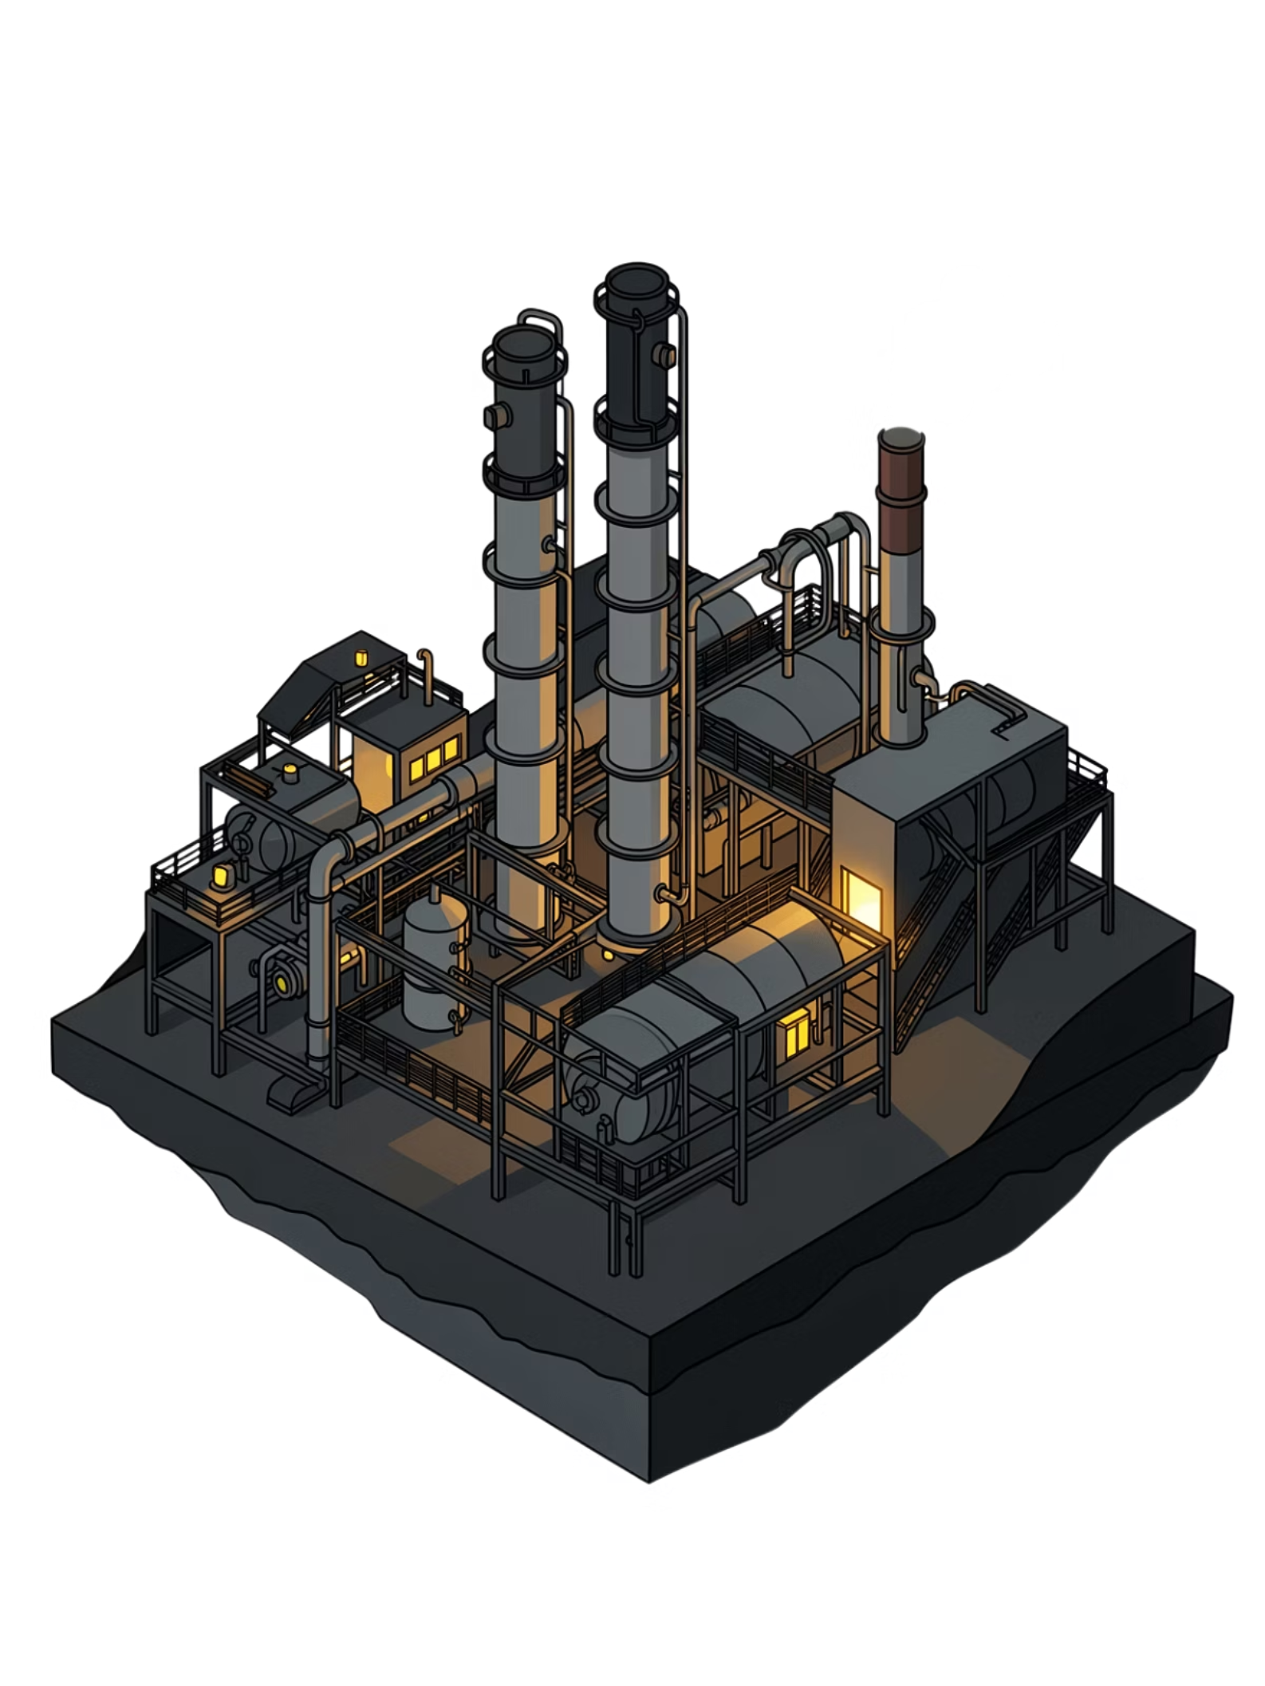
The Takeaway
Delta Lake doesn't replace the data lake. It fixes it.
"If data is oil, Delta Lake is the refinery that makes it usable."
01
02
Understand the Problem
Adopt Delta Lake
Raw data lakes lack ACID guarantees — reliability must be added.
Open-source, Parquet-based, and compatible with every major cloud platform.
03
Build Reliable Pipelines
Use MERGE, time travel, and schema enforcement to ship with confidence.
🌐 www.cloudpandith.com | 📞 8904424822 — Learn Delta Lake with CloudPandith

